Slide 1

Image processing for mold damage detection
ME 781 Course Project: Demonstration Presentation
Guide: Prof. Asim Tewari
GROUP-13
B rijal kumar prajapati (203180010)
0 mprasad vibhute (19D100012)
S umit bhong (190100121)
S amyak ajmera (19B080023)

Slide 2
Problem Objective and Introduction
What ? | A robust tool for early, fast, accurate and automated detection of defects present in mold using two computer vision based techniques, Deep Learning and OpenCV
Who ? | A startup in the field of AI-Manufacturing aiming to redefine the manufacturing sector in India and become a strong pillar in providing reliable and accurate damage detection services.
Why ? | A much more productive and fully automatic . So it also reduces the amount of labour required for the quality checking process of the mold.It will increase the efficiency in manufacturing with more profit.

Slide 3
Problem Definition
Customer requirement | Fast, accurate, robust, and reliable defect detection solutions to the manufacturing industry at an affordable price range.
Market survey | Viking Analytics and iioote (detecting mold), The U.S. Centers for Manufacturing Control and Prevention(mold quality inspection) , Siemens(AI solution in manufacturing)
Key differentiator | 3 to 4 manufacturing problem solutions which include defect detection, defect classification, bounding box detection and estimating defect size.
Unique selling point (USP) | High accuracy (>90%), sensitivity and specificity as compared to conventional methods and other and other available solutions.
Protection of USP | Code encryption and secure and reliable cloud and continuous updation of data for the model Patenting and copyrighting of our startup solutions
Barrier to entry | Patents and copyright issues from other startups/companies working in the field.Due to automation, there is an increase in unemployment of workers which are engaged in the quality checking process.

Slide 4
Technology landscape assessment
Published literature | http://researchgate.net/publication/340968740_Real_Time_Mold_Quality_Inspection_in_Foundries_using_Image_Processing_Techniques https://www.researchgate.net/publication/339105848_Inspecting_Method_for_Defective_Casting_Products_with_Convolutional_Neural_Network_CNN https://www.researchgate.net/publication/245282260_Analysis_of_Edge-Detection_Techniques_for_Crack_Identification_in_Bridges https://www.researchgate.net/publication/322512435_Automatic_localization_of_casting_defects_with_convolutional_neural_networks https://www.researchgate.net/publication/327384743_Using_Artificial_Neural_Networks_for_Detecting_Damage_on_Tobacco_Leaves_Caused_by_Blue_Mold https://www.researchgate.net/publication/322787719_Road_Damage_Detection_Using_Deep_Neural_Networks_with_Images_Captured_Through_a_Smartphone
Open libraries | Numpy, OpenCV ( SIFT and SURF), Matplotlib, Keras, Imutils, Argparse, PIL(python Imaging Library) by ImageChops
Proprietary libraries | https://www.kaggle.com/ravirajsinh45/real-life-industrial-dataset-of-casting-product

Slide 5
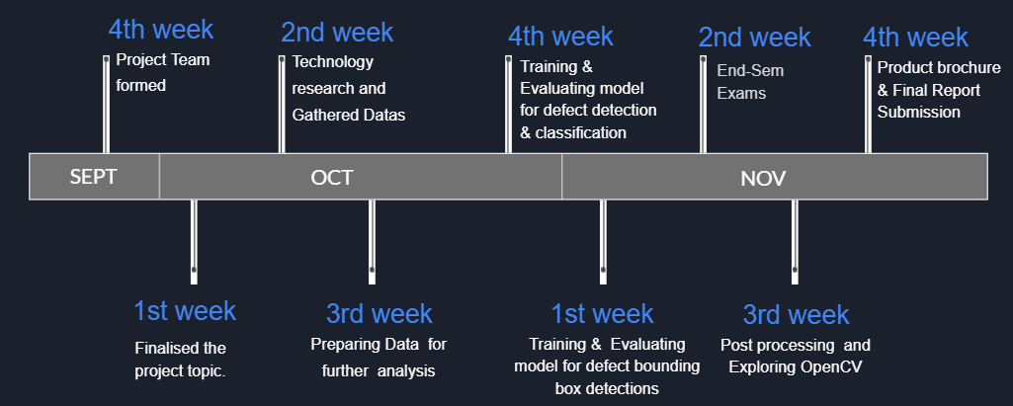
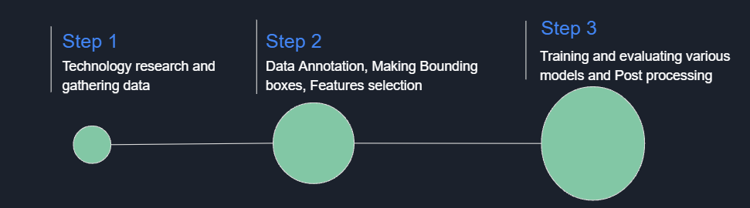
Project timeline

Slide 6
Tasks Completed | 10/10-16/10 | 17/10-23/10 | 24/10-30/10 | 31/10-6/11 | 14/11-20/11 | 21/11-24/11
Technology Research | Brijalkumar Prajapati
Data Gathering | Omprasad Vibhute
Data Transformation | Sumit Bhong
Making bounding boxes manually | Samyak Ajmera
Training and Evaluating model for defect detection and classification |  |  | Sumit Bhong
 |  |  | Brijalkumar Prajapati
Training and Evaluating model for defect bounding box detections |  |  | Omprasad Vibhute
 |  |  | Samyak Ajmera
Code documentation and Product brochure |  |  |  |  | Brijalkumar Prajapati
Marketing Slides and Video |  |  |  |  | Omprasad Vibhute
Final Report and OpenCV |  |  |  |  | Samyak Ajmera
Presentation Slides |  |  |  |  | Sumit Bhong

Slide 7
Conceptual Design
For the detection of the presence of the defect we proposed an inspecting system supported by the deep learning algorithm (CNN). We implemented our model on 6633 training images containing both defected and sound images
The dataset we used had three kinds of defects which included Blowholes , Metallic projections and both blowholes and Metallic projection
For the classification of these defects again we used our Convolutional Neural Network algorithm with appropriate changes to detect the type of defect
For localization of defect within the image, we annotated around 3000 images containing defective images and trained it using the YoloV3 model
We then used OpenCV to find defects in casting products using 2 similar images with one non defective casting product and the other containing defect
We have used ‘pixel per metric ratio’ to estimate defect size in casting products

Slide 8
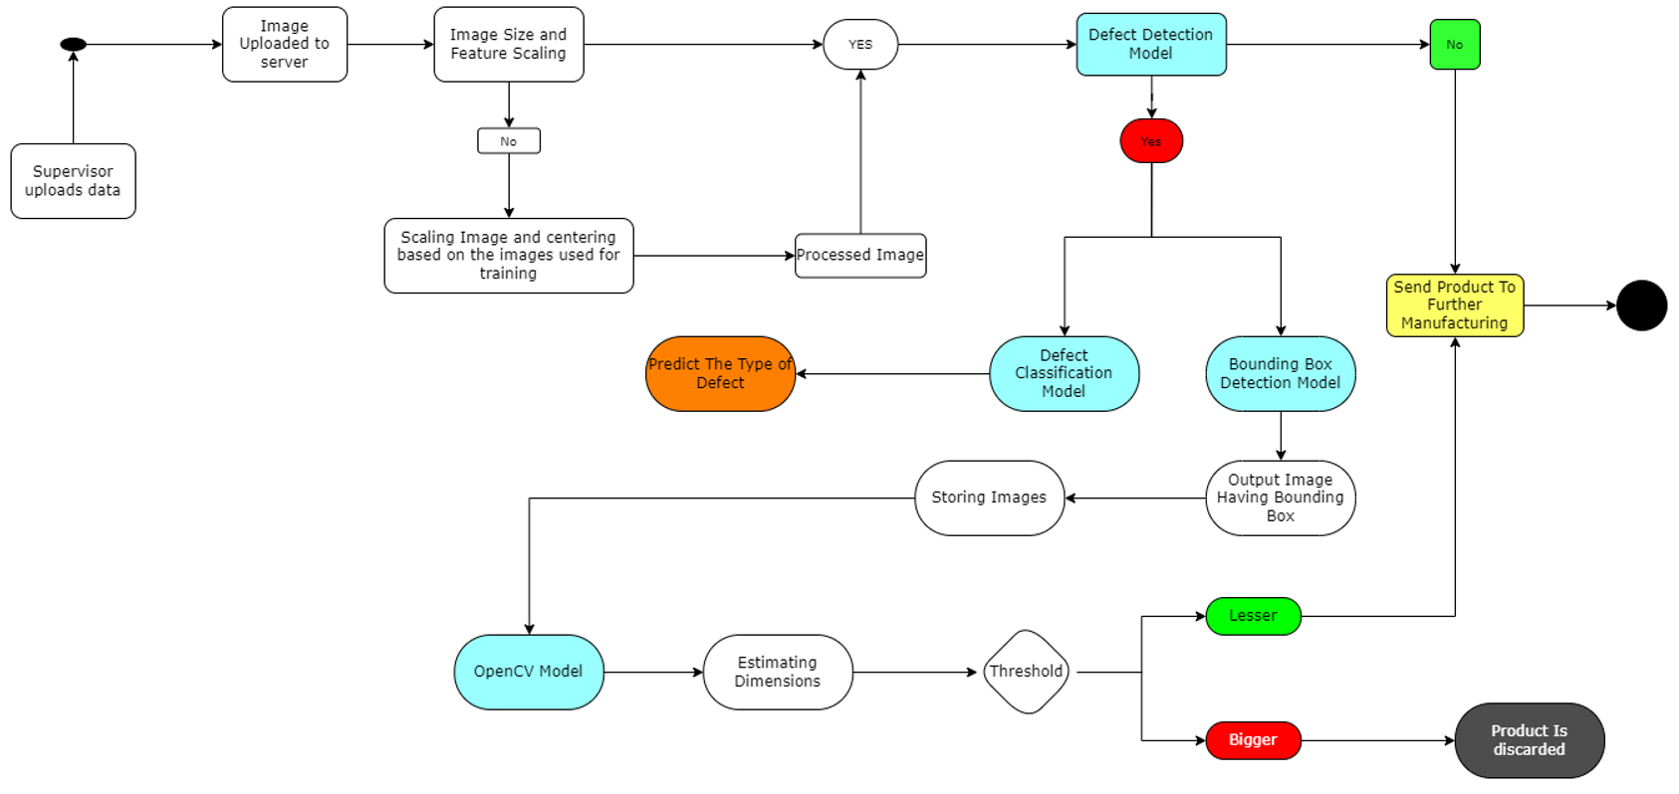
High Level Activity Object Diagram

Slide 9

User Interface

Slide 10
Unit Test report
Our model expects images of products at every checkpoint of manufacturing using high quality cameras making 360º in order to provide a continuous set of images to our server
After uploading an image to the server the image will be pre processed and centralized as per our model and the parameters of image are also feature normalised
We perform data pre-processing with a good enough time on our end so that no discrepancies can come in the time of prediction which then successfully passes all testing parameters required in the code testing part
After performing above tasks, an image is sent to our first model ( defect detection) which will check if the defect exists or not
Next we will go for openCV for estimating dimensions and if the defect dimension is avoidable we will send it to further manufacturing and if not then discard

Slide 11
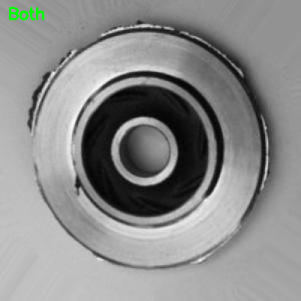
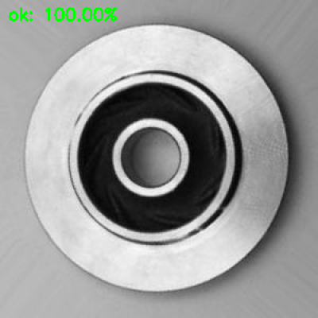
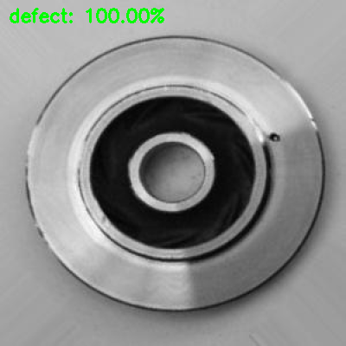
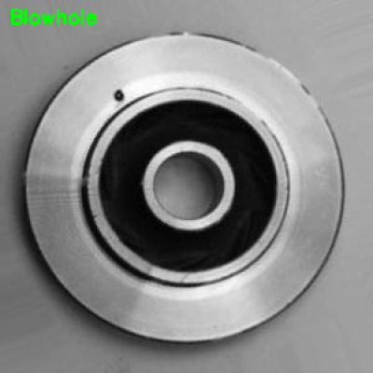
Model training and testing report
Defect Detection : Predicted the presence of defects with an accuracy of 92.33% on the training dataset and an accuracy of 87.34% on the test dataset
Defect Classification :

Slide 12
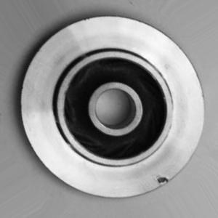
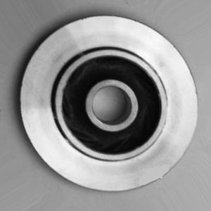
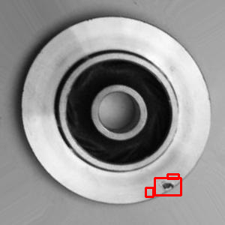
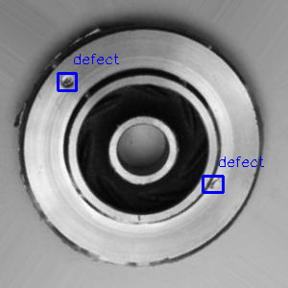
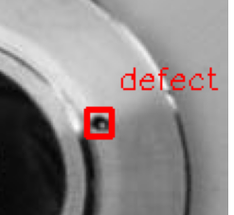

Model training and testing report
Bounding Box Detection : Overall test accuracy of the model was 99%.
OpenCV Methods :
Defective
non-defective
Output

Slide 13


